Slide 1

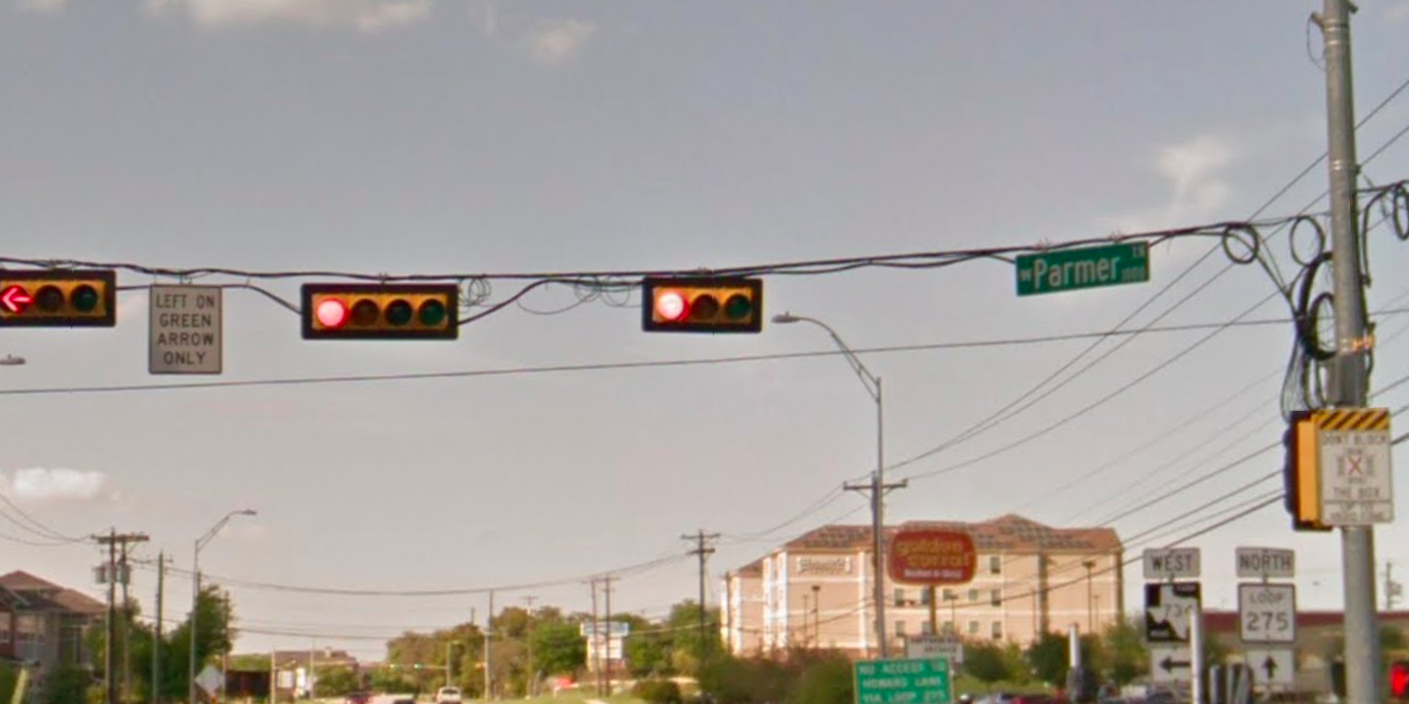
Austin Transportation Department Signs Work Orders
Created By: Susanne Gov Created Date: 2020-08-10 Location Name: LAMAR BLVD / PARMER LN Intersection ID: 5164152 Cardinal Direction: N Work Order ID: SG-20519
Sign Type | Install/Remove
Left On Green Arrow Only | Install
Street Name Sign | Install
Don’t Block the Box | Install

Slide 2
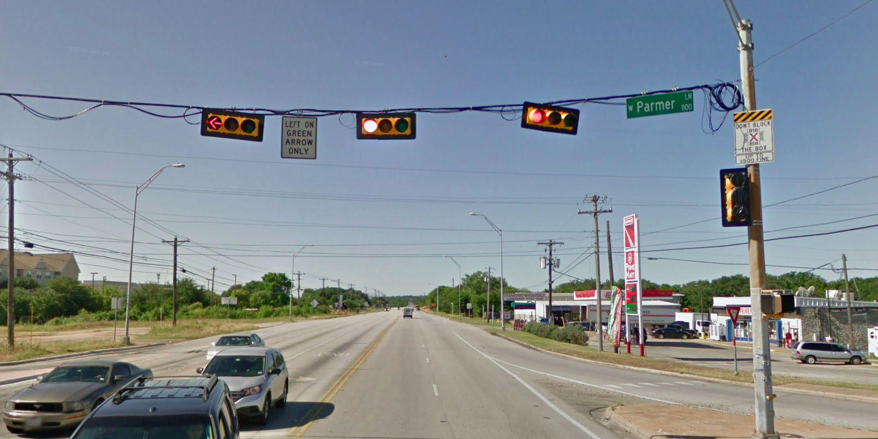
Austin Transportation Department Signs Work Orders
Created By: Susanne Gov Created Date: 2020-08-10 Location Name: LAMAR BLVD / PARMER LN Intersection ID: 5164152 Cardinal Direction: S Work Order ID: SG-20519
Sign Type | Install/Remove
Left On Green Arrow Only | Install
Street Name Sign | Install
Don’t Block the Box | Install

Slide 3
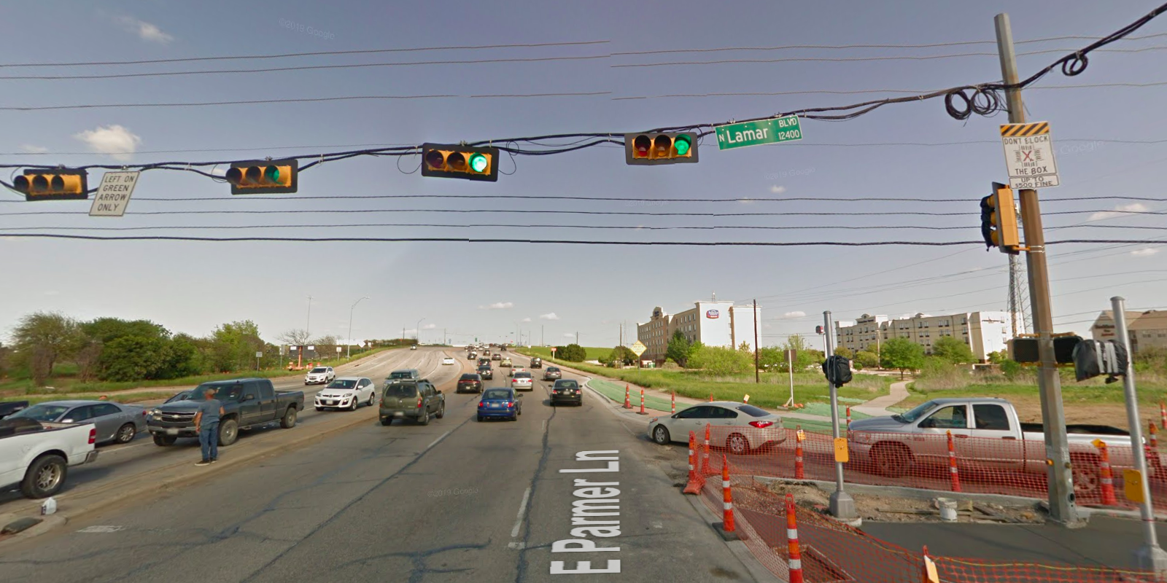
Austin Transportation Department Signs Work Orders
Created By: Susanne Gov Created Date: 2020-08-10 Location Name: LAMAR BLVD / PARMER LN Intersection ID: 5164152 Cardinal Direction: E Work Order ID: SG-20519
Sign Type | Install/Remove
Left On Green Arrow Only | Install
Street Name Sign | Install
Don’t Block the Box | Install

Slide 4
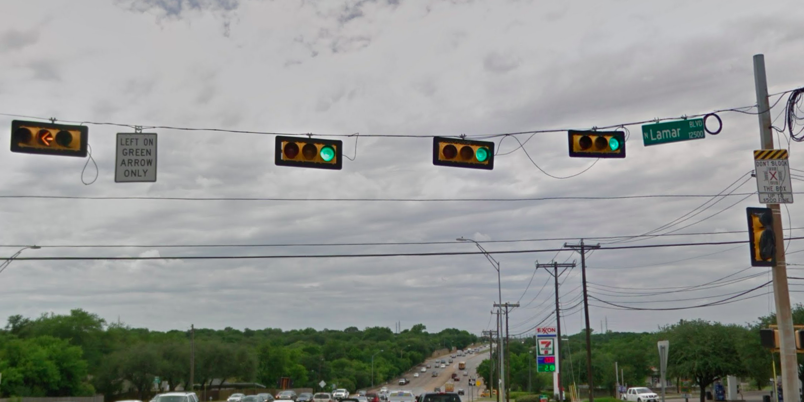
Austin Transportation Department Signs Work Orders
Created By: Susanne Gov Created Date: 2020-08-10 Location Name: LAMAR BLVD / PARMER LN Intersection ID: 5164152 Cardinal Direction: W Work Order ID: SG-20519
Sign Type | Install/Remove
Left On Green Arrow Only | Install
Street Name Sign | Install
Don’t Block the Box | Install

